Slide 1
The Drivers of Tropical Cyclone Interannual Variability in the Northwest Pacific
Joshua Coupe

Slide 2
Outline
Introduction & Motivations
TCHP changes since 1993
Atmospheric drivers: features that modulate the Monsoon Trough
MJO
QBWO
ENSO
Reverse Oriented Monsoon Trough (RMT)
Tropical Upper Tropospheric Troughs
Quantifying contributions
Conclusion

Slide 3
Introduction & Motivations
Project inspired by a previous analysis of Tropical Cyclone Heat Potential (TCHP) in the northwestern Pacific Ocean.
TCHP is a representation of the maximum oceanic energy available for tropical cyclogenesis given ideal atmospheric conditions.
Thinking was that areas with increases in TCHP would see an increase in ACE…
However, this was not the case in the northwestern Pacific.
Notes:
The TCHP is the total integrated heat down to the 26 degree C isotherm.

Slide 4
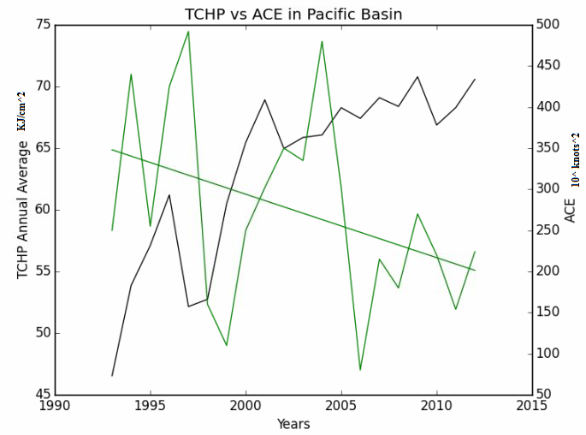
Methods
The calculation for TCHP in the western Pacific was defined within the boundaries of:
115°E and 180°E, 5°N and 30°N
Using the GLORYS global ocean reanalysis at ¼ degree resolution from 1993 to 2012 between May and November.

Slide 5
Results
* Despite steady increases in TCHP, ACE has trended down during the same time period.
Finding a reason to explain this has been the main motivation of this project.
The ocean heat content is clearly not driving changes in tropical cyclogenesis, so we seek for answers in the atmosphere.

Slide 6
The Atmospheric Drivers of Tropical Cyclones
A number of mechanisms act on seasonal/interannual timescales, including but not limited to…
the MJO, QBWO, Tropical Upper Tropospheric Troughs, ENSO…
Anything that interacts with the Monsoon Trough impacts tropical cyclogenesis.
Why the Monsoon Trough?
It’s a convergence zone that forms in the western Pacific between May and September.
characterized by high mid-level relative humidity, strong low level cyclonic relative vorticity, and weak vertical wind shear (Hujiun and Liguang, 2014)

Slide 7
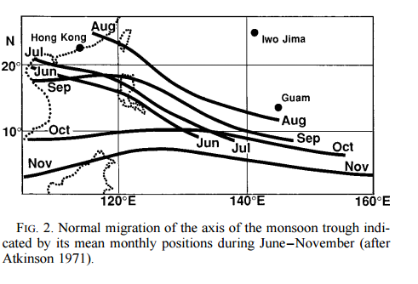
The Monsoon Trough
Molinari and Vollaro (2013) found that 73% of all tropical cyclones that formed between July and November were formed within the monsoon trough for the years between 1988 and 2010.
Variability in the Monsoon Trough is a major driver of tropical cyclogenesis.
-Strengthened MT can focus surface vorticity, increase moisture, and set up easterly vertical wind shear.
How the MT varies depends on the interaction of many climate modes...

Slide 8
Reverse Oriented Monsoon Trough (RMT)
The RMT is a mode of seasonal variability in the positioning of the monsoon trough that affects where tropical cyclones form.
Although it acts on a seasonal scale, its variation in strength from year to year can have impacts on interannual variability of tropical cyclones.
Tropical cyclones have a more northerly track; activity diminished altogether. (Landers 1996)
Potential link between La Nina conditions and the RMT.

Slide 9
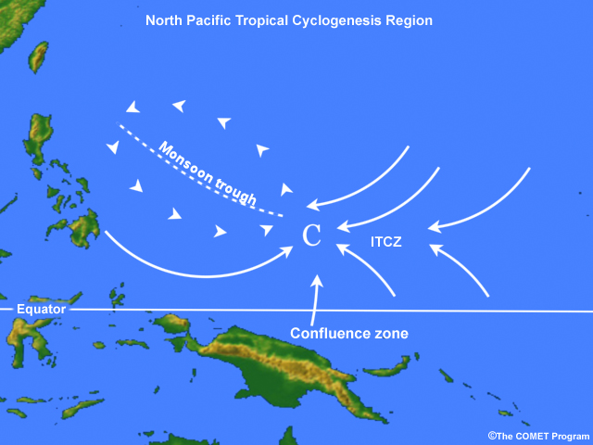
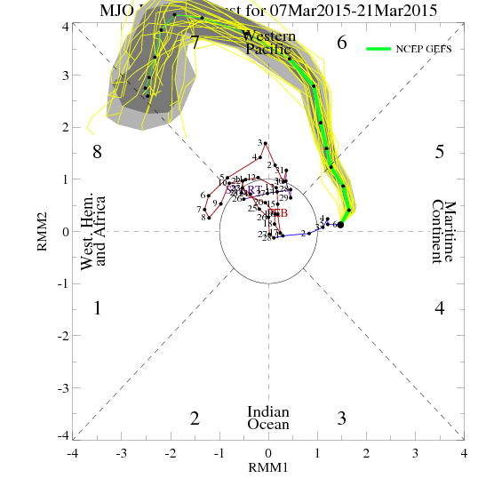
The Madden Julian Oscillation (MJO)
During phases 1-2 and 7-8, tropical cyclone activity has been shown to increase. (Li and Zhou, 2012)
The MJO is directly responsible for creating an environment favorable for the organization of convection.
The propagation of a wave into the convergence zone set up by the MT has a very good chance of becoming a TC.
23% of tropical cyclones are linked t to an active MJO.

Slide 10
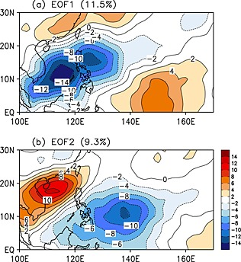
The Quasi Bi-Weekly Oscillation (QBWO)
The QBWO is an oscillation on the scale of 10 to 20 days linked with the intraseasonal variability of the summer monsoon in India.
* characterized as a westward moving coupled anticyclonic and cyclonic system in the western north Pacific. (equatorial Rossby wave dynamics)
-higher frequency than the MJO
As westward moving disturbance approaches the monsoon trough, waves can get trapped and undergo tropical cyclogenesis.
20% of tropical cyclones are associated with an active QBWO

Slide 11
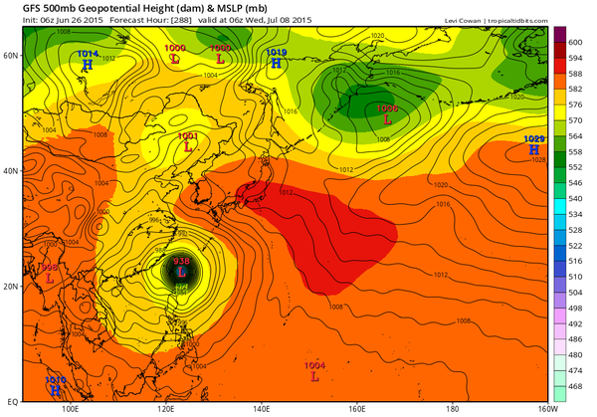
ISO: MJO and the QBWO combined
ISO is the intraseasonal oscillation, a combination of both MJO and QBWO dynamics.
43% of northwestern Pacific tropical cyclones form when the MJO and QBWO are active. (Li and Zhou, 2012)
Together, they are able to create a favorable background environment in the vicinity of the monsoon trough for tropical cyclone development.

Slide 12
El Nino Southern Oscillation (ENSO)
Increase in SST in the central Pacific during warm ENSO events can fuel individual tropical cyclones…
Of 13 El Nino years studied between 1950 and 2002, only one recorded ACE values below the median (Camargo and Sobel, 2005)
However, according to Chan and Liu (2004): SST have a small role in the variability in tropical cyclone formation during ENSO events
Warm ENSO events shift the monsoon trough to the SOUTHEAST.
→ This leads to moisture convergence just south of the monsoon trough and sets up conditions for tropical cyclones with long lifespans and higher intensities.
During La Nina (cold ENSO events), less ACE is observed and ACE per storm is significantly lower.

Slide 13
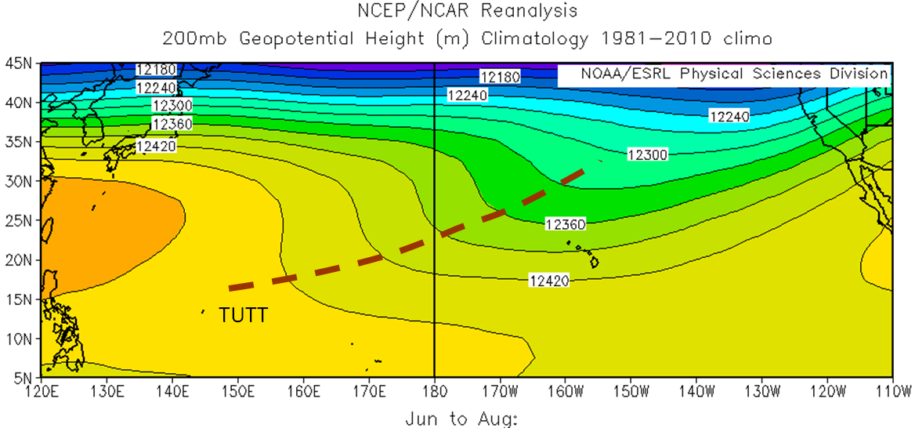
Tropical Upper Tropospheric Trough (TUTT)

Slide 14
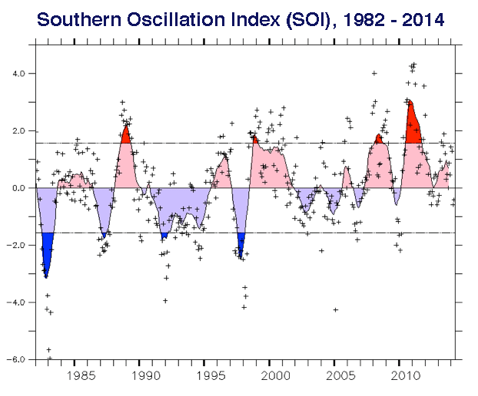
Tropical Upper Tropospheric Trough (TUTT)
TUTT is an upper level feature over the Central Pacific which moves east-west on interannual scales.
During west years, TC formation is inhibited in the Central Pacific. (1995, 1998, 2010)
During east years, TC formation is enhanced in the Central Pacific. (1994, 1997, 2002, 2004)
A clear ENSO signal is found.

Slide 15
Tropical Upper Tropospheric Trough (TUTT)
(Wang and Wu, 2016)
Hypothesize that variations in the TUTT are influenced by SST variations due to ENSO.
During east years: warm SST in the C. Pacific leads to ascent, descent over maritime continent. Anomalous westerlies are formed, extending the MT east.
Despite Chan and Liu (2004) saying that SSTs have little role in TC development, new research suggests they modulate this important feature.

Slide 16
So back to this...
Using the TUTT:
West years: La Ninas 1995, 1998, 2010
-Decreased ACE in all of these years.
East years: TC formation is enhanced in the Central Pacific. (1994, 1997, 2002, 2004)
+Increased ACE in all years.
This explains only some of the interannual variability and leaves out decadal trends.

Slide 17
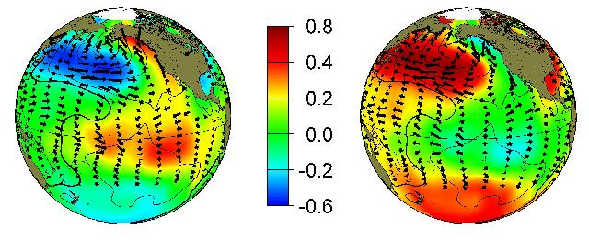
Look to the Pacific Decadal Oscillation (PDO)
Associated with shifts in the long term distribution of SSTs in the Pacific
Warm Cold

Slide 18
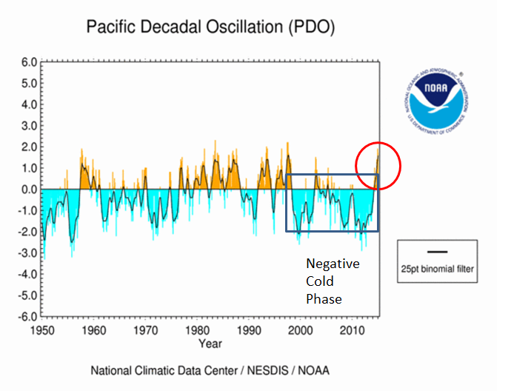
Zhao and Wang (2015)
“ENSO is the strongest signal of the interannual variation of the ocean atmosphere system…”
Coupled with a ‘cold’ PDO phase … circulation anomalies in the long term create unfavorable conditions for tropical cyclones.

Slide 19
Conclusion
ENSO’s interactions with the TUTT and the MT generate an atmospheric environment favorable for tropical cyclogenesis in conjunction with warm SSTs.
The role of the MJO and QBWO within ENSO serve to amplify conditions for tropical conditions by shifting the MT southeastward.
On even longer timescales, the PDO sets the heartbeat for tropical cycloen formation.

