Slide 1
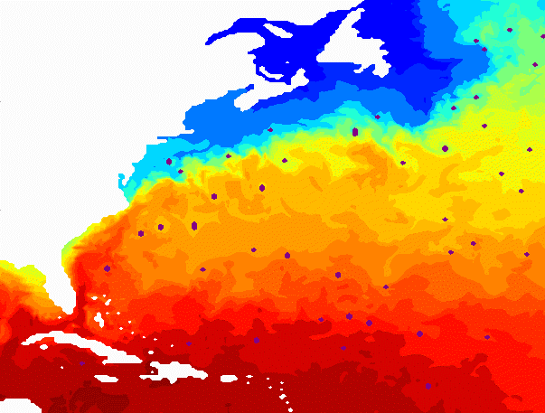
Eddy Characteristics in an Ocean Model Reanalysis
Joshua Coupe
Advisor - Enrique Curchitser

Slide 2
Outline
Introduction
Methods/Algorithm Description
Seasonal Variability of Gulf Stream Eddy Characteristics
Interannual Variability of the Gulf Stream
Seasonal Variability of Kuroshio Current Eddy Characteristics
Interannual Variability of Kuroshio Current
Summary

Slide 3
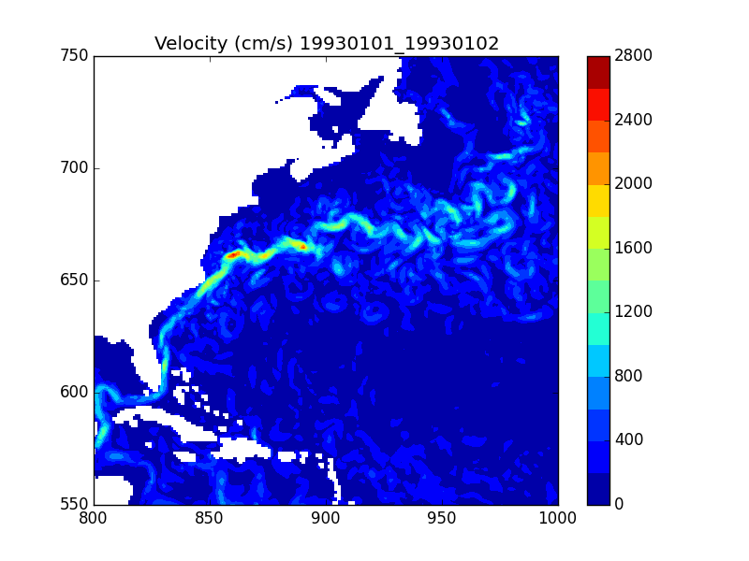
Introduction
An eddy is a swirling fluid and is the result of the transfer of momentum and energy from large to smaller scales.
It can be formed through …
Meanders in western boundary currents
(Gulf Stream, Kuroshio Current, etc.)
2. Instabilities in the flow
3. Bottom topography interactions

Slide 4
What I Set Out To Do
Come up with a quantitative description of Gulf Stream and Kuroshio eddies. Why?
Climate implications, biological productivity, larvae transport, etc.
Ex: cyclonic eddies advect cold, productive water into the Sargasso Sea.
Apply an eddy tracking and detection algorithm to a global ocean model reanalysis.
Used the GLORYs global ocean reanalysis at ¼ degree resolution over the years 1993 to 2012.
...all to determine a connection between eddy formation and a climate mode.
Ultimately this assists in understanding the most prominent western boundary currents, as eddies affect the main flow.

Slide 5
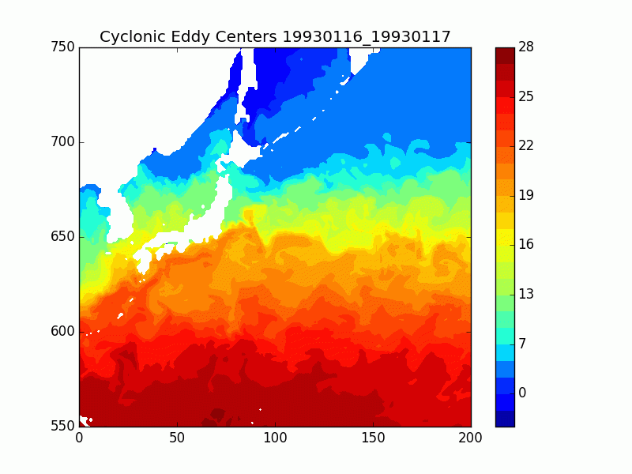
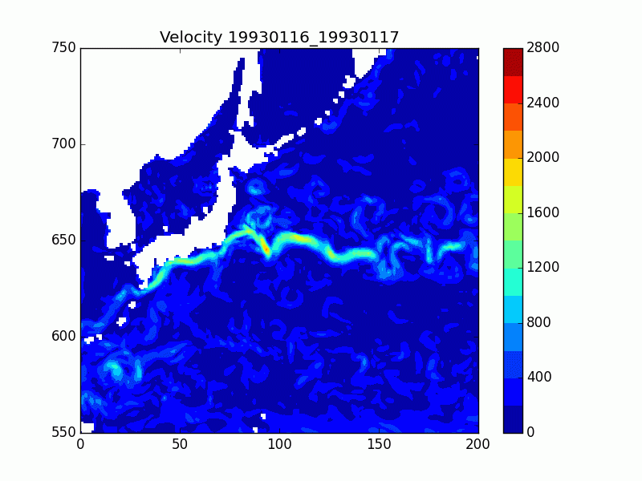
Importance
Temperature (Celsius)

Slide 6
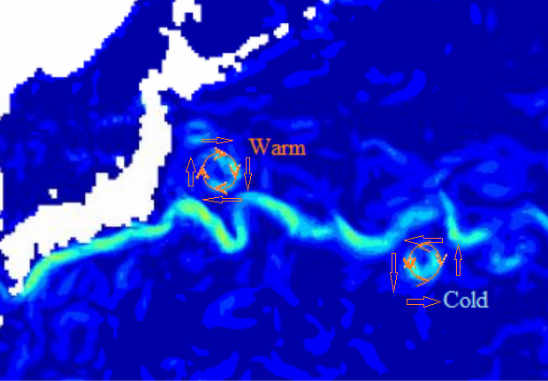
Types of eddies
An eddy falls into two categories in the northern hemisphere: Cyclonic (cold) and Anticylonic (warm) eddies
→ Anticyclonic eddies advect warm water into colder regions (propagate west)
→ Cyclonic eddies advect cold water into warmer regions (propagate southwest)

Slide 7
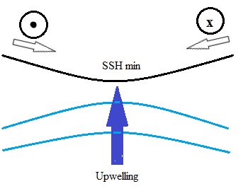
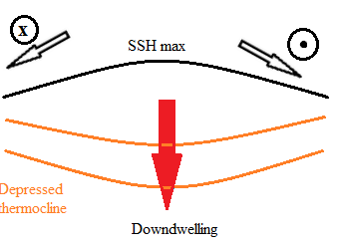
Anticyclonic Eddies
Cyclonic Eddies

Slide 8
Eddy Detection Algorithm*
An eddy is identifiable by a number of characteristics.
A maxima (minima) in the SSH field for anticyclonic (cyclonic) eddies.
Okubo Weiss parameter at a minimum (negative)
-indicates that the flow is dominated by vorticity [positive or negative]
3. Geometric constraints derived from the velocity field
*Adapted from Gulf Stream eddy characteristics in a high-resolution ocean model (Kang and Curchitser, 2013)

Slide 9
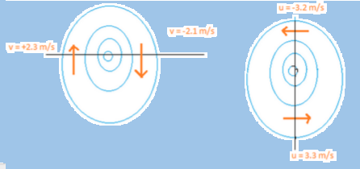
Geometric Constraints (cont’d)...
Coherent flow is analyzed by applying these filters.
The v-component vector must change sign across east-west axis.
The u-component vector must change sign across north-south axis.
The ratio of velocity must be below a certain threshold. (5)

Slide 10
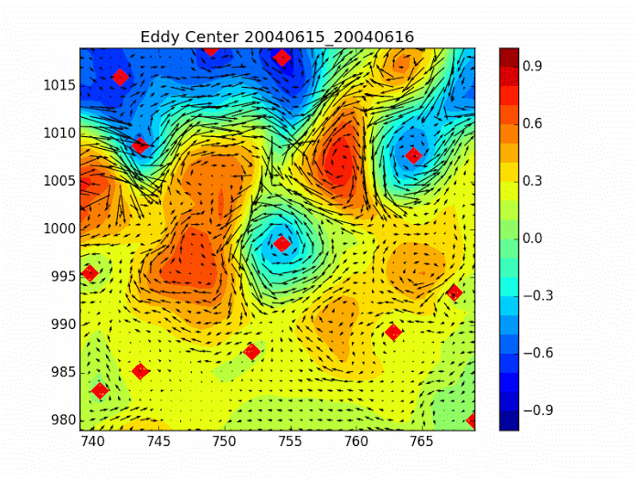
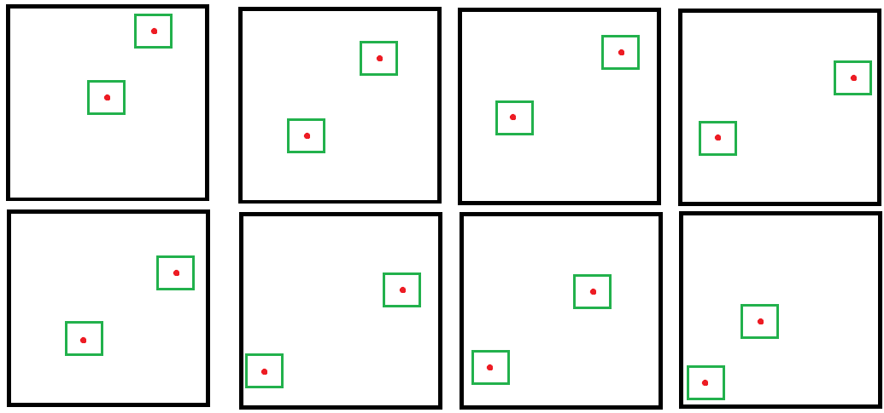
Eddy Tracking Algorithm
Only caring about eddies that last longer than 15 days.
At t = 0 days, all detected eddies are logged. If on day t+1, an eddy is detected in a 6x6 box around the eddy on day 0, the new coordinates are logged.
Continues until an eddy is not detected in a box for 2 days.
This marks the end of the eddy’s life.

Slide 11
Determining eddy radius and intensity
Eddy radius is derived from defining eddy as the closed contour where
OW = 0.2𝜎 where 𝜎 is one standard deviation of the OW field.
-The area that the contour encompasses is the area of the eddy, and so the radius = ⎷(A/𝝅)
Eddy intensity is |ω|/ f where ω is the absolute mean relative vorticity within the boundary of the eddy and f is the Coriolis parameter, which at mid-latitudes we use a constant 7.3 x 10⁵.

Slide 12
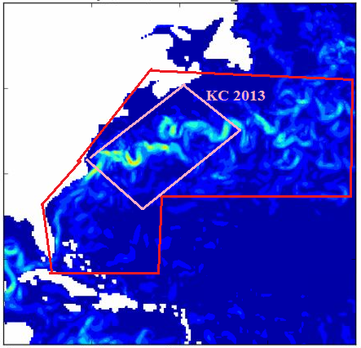
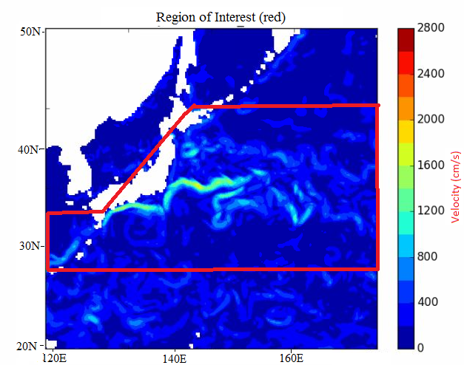
Areas of Interest

Slide 13
Original goal was to find an NAO link...
Theoretically sound but the real world is never as simple or linear.
NAO: North Atlantic Oscillation.
A measure of the strength of the pressure gradient between the Icelandic Low and the Azores High.
+NAO indicates a strong pressure gradient with strong westerly winds.
-NAO indicates a weak pressure gradient with a meandering jet stream.
THEORY: stronger westerlies → stronger wind stress → more EKE →
More numerous, larger, more intense GS eddies!
Nope, too simple.

Slide 14
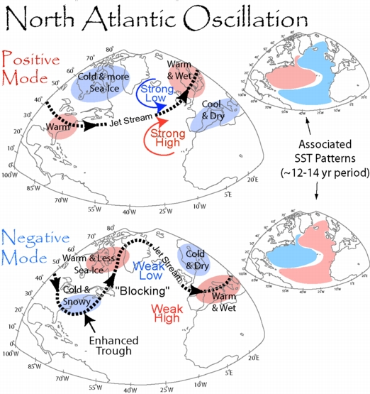

Slide 15
Seasonal Variability of GS Eddies
Reasons for seasonality include:
Variations in wind stress which affects eddy kinetic energy.
Wind stress during the winter, as well as thermal forcing creates a baroclinic environment.
This is favorable environment for the baroclinic conversion of energy into the development of an eddy.
Bottom topography/continental shelf forcing.
Variations in the mean positioning of the Gulf Stream.
The NAO may impact (1), but many other factors involved as well as interannual oscillations.

Slide 16
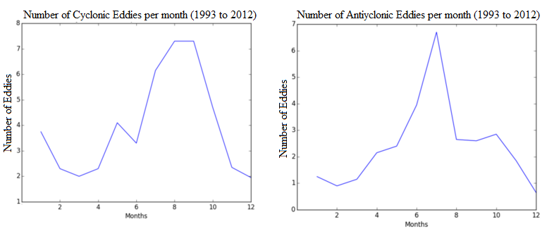
Seasonal Variability of GS Eddies
In number of eddies:
Similarities?
Peak in Autumn.
Similar trends.
Differences?
Anticyclonic eddy peak
in July for this study.
Different regions.

Slide 17
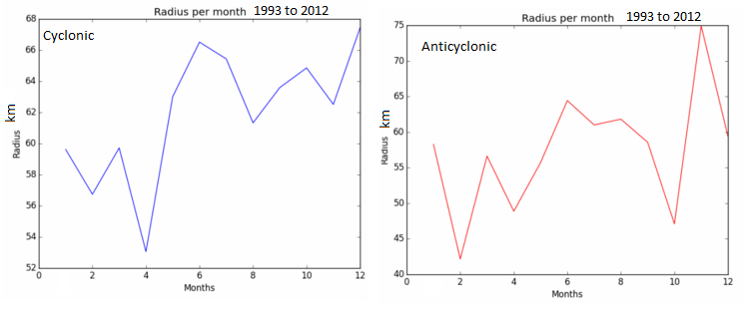
Seasonal Variability of GS Eddies
In size of eddies:
Similarities?
Significant variability.
Peaks near the same time.
Differences?
More variability in eddy size.

Slide 18
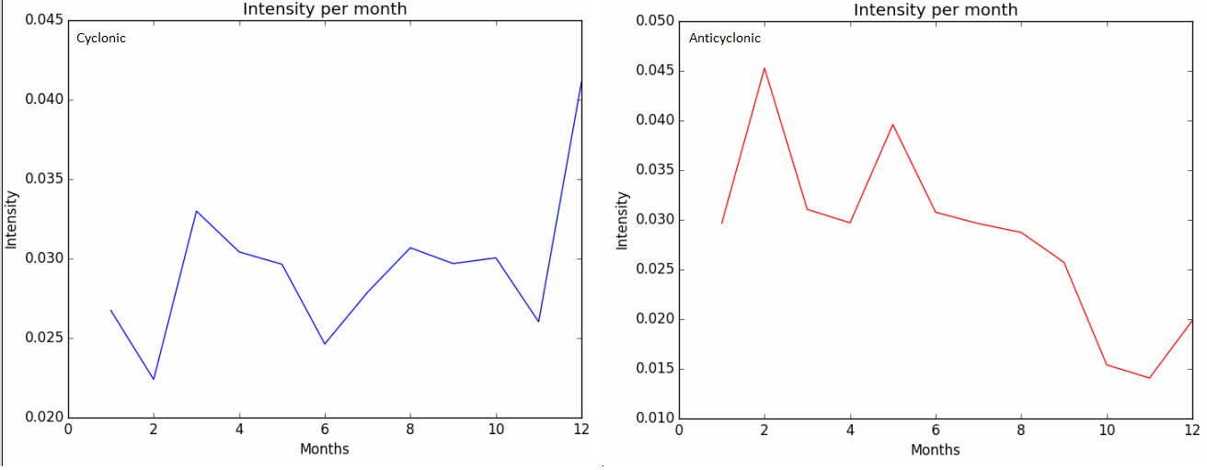
Seasonal Variability of GS Eddies
In intensity of eddies:
Similarities?
Decline with anticyclonic.
Differences?
Cyclonic intensity all over.
Anticyclonic more intense.
-could be attributed to low
resolution data.

Slide 19
Interannual Variability of GS Eddies
Mechanisms which act on an interannual sale:
Variations in the northern extent of the Gulf Stream.
Southward flow of cold Labrador surface water.
Deep Western Boundary Current.
Wind stress responding to variations with the NAO.
The El Nino-Southern Oscillation.
Taylor et al. (1998) found 60% of the variance in the positioning of the Gulf Stream is attributable to the NAO.
Therefore, it is unlikely to find an NAO signal in characteristics derived from a mechanism that provides only 60% of variation in larger scale system.

Slide 20
Interannual Variability of GS Eddies
Variations in the northern extent of the Gulf Stream.
Northerly mode of the Gulf Stream decreases the area available for anticyclonic eddy formation.
-closer to the continental shelf, stronger surface transport
Southerly mode of the Gulf Stream increases the area available for anticyclonic eddy formation.
-more meandering and increases likelihood of eddies shedding from instabilities in the Gulf Stream current.

Slide 21
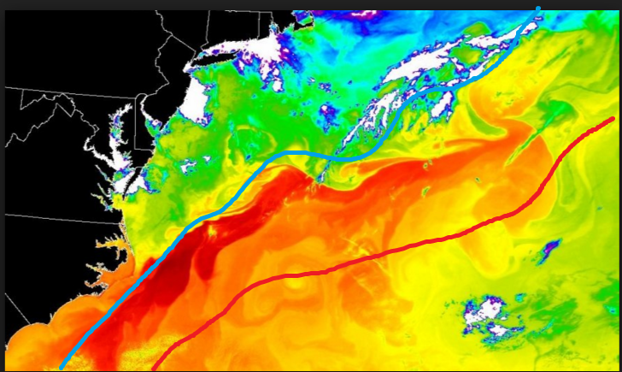
Interannual Variability of GS Eddies

Slide 22
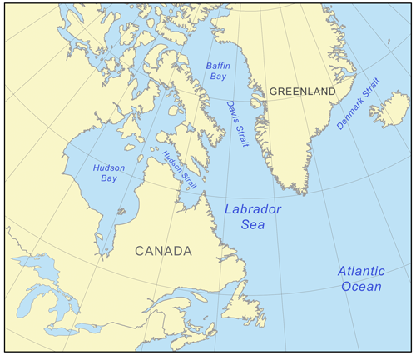
Interannual Variability of GS Eddies
2) Southward flow of cold Labrador surface water.
Southward intrusions of cold water from the Labrador Sea has been shown to shift the Gulf Stream south [Taylor et al. (1998)].
-extrapolating further, colder winters may lead to a
more southerly, meandering mode.

Slide 23
Interannual Variability of GS Eddies
3) Deep Western Boundary Current.
The current which flows southward far under the surface can alter the Gulf Stream as well.
4) Wind stress responding to variations with the NAO.
5) The El Nino-Southern Oscillation.

Slide 24
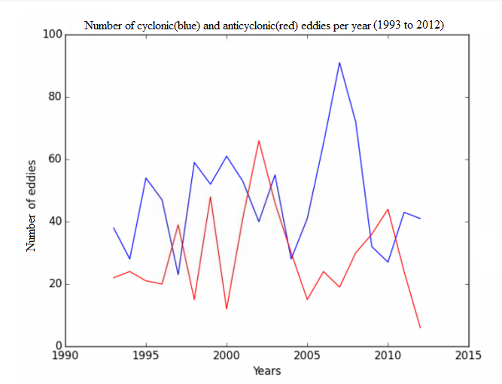
Interannual Variability of GS Eddies [NAO]
In number of eddies:
+NAO brings GS north.
-NAO brings GS south.
Sep 2011 - April 2012 was a
period of very positive NAO.
This led to less anticyclonic eddies.

Slide 25
Interannual Variability of GS Eddies [ENSO]
In number of eddies:
Perez-Hernandez (2014): GS at its
most northerly extent in July ‘95,
October ‘00 and April ‘12.
-Anticyclonic eddies diminished in
Years after.
In a northerly mode, less area
available for the formation of
anticyclonic eddies.

Slide 26
Interannual Variability of GS Eddies [ENSO]
In number of eddies:
ENSO warm phase lag rule: 1.5yrs
after warm ENSO, Gulf Stream
is more northerly.
*Due to changes in the subtropical
jet stream in a warm ENSO year, the
North Atlantic gyre is affected.
1992/1997 warm ENSO yrs:
-1.5 yrs later, diminished eddies.

Slide 27
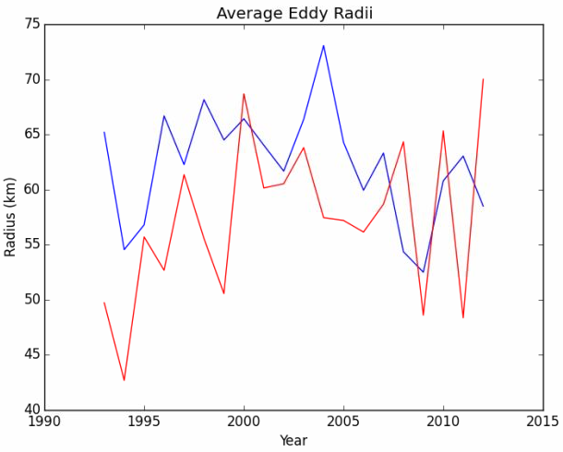
Interannual Variability of GS Eddies
In size of eddies:
No real relationship found with major climate
modes in terms of eddy radius.
-Largest eddies found in 2000 and 2003.
- Hints of a decadal trend in overall eddy radii.
Radii increase from 1993 to 2004, fall, then
Stabilize after 2005.

Slide 28
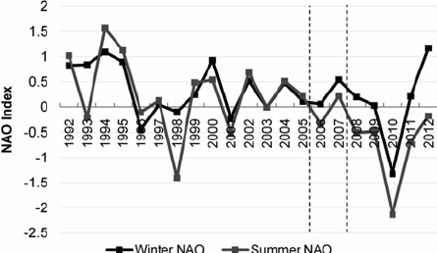
Interannual Variability of GS Eddies
In size of eddies:
No robust relationship found with major climate
modes in terms of eddy radius, weak NAO link.

Slide 29
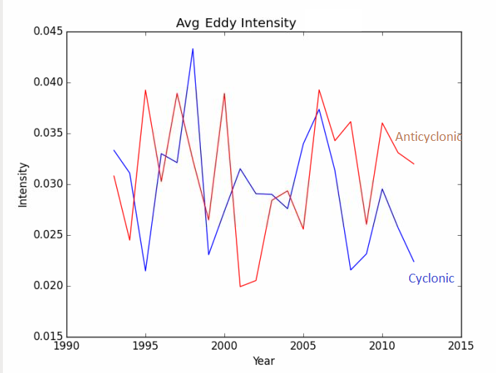
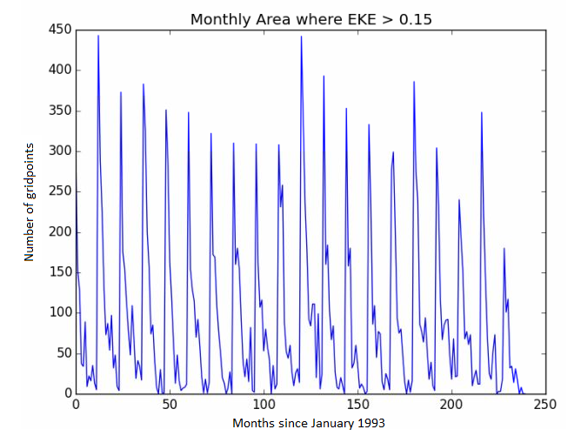
Interannual Variability of GS Eddies
In intensity of eddies:
No correlation with the NAO on interannual scales.
Eddy kinetic energy often influences eddy intensity.

Slide 30
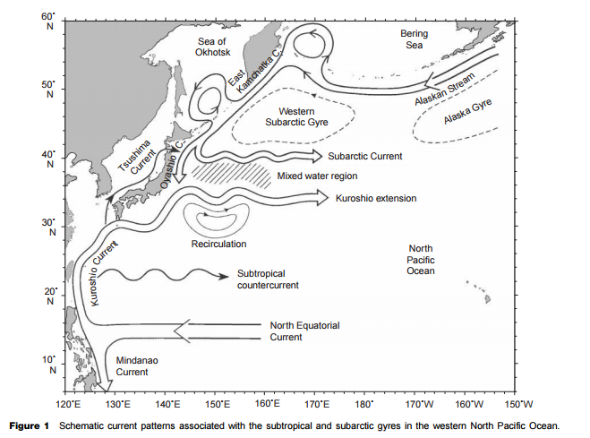
Kuroshio Current
Qiu, 2001

Slide 31
Variability in Kuroshio Eddies
Many of the same dynamics at play here as in the Gulf Stream.
Northward extent of Kuroshio current determines meandering strength.
Wintertime cooling has similar effects as were found in the Gulf Stream.
Bottom topography effects.
All of these occur on a combination of seasonal and interannual scales.

Slide 32
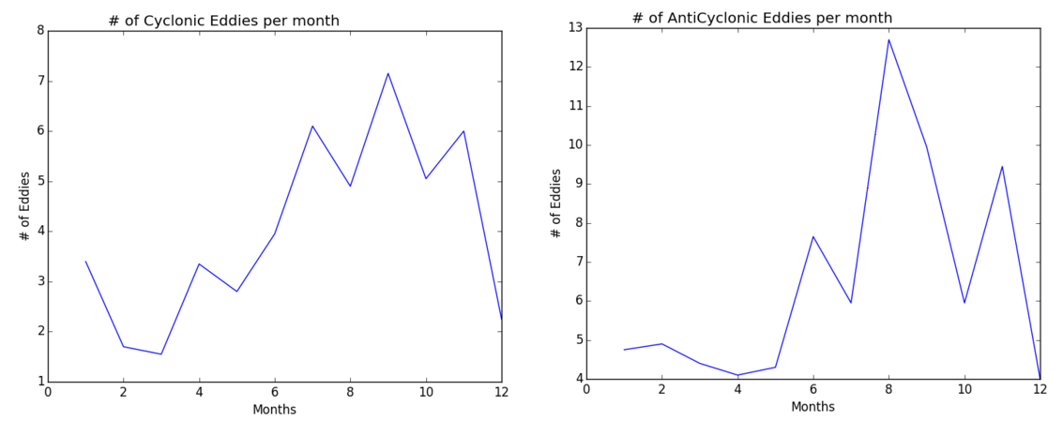
Seasonal Variability in Kuroshio Eddies
Peak in both types of eddies found towards the autumn months.
→ Peak in eddies lags the wind forcing by a few months.
→ Not much variation between cyclonic and anticyclonic eddies-- but more eddies in general.

Slide 33
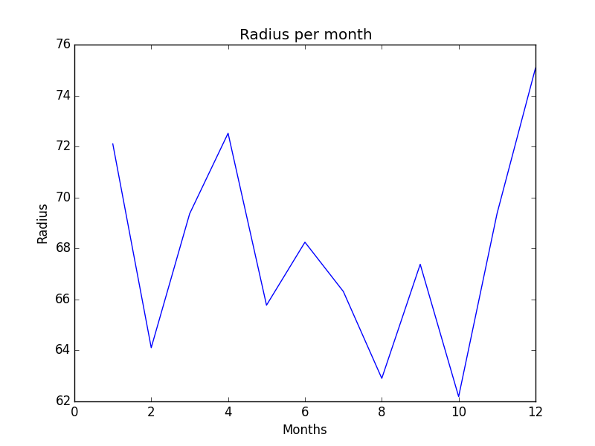
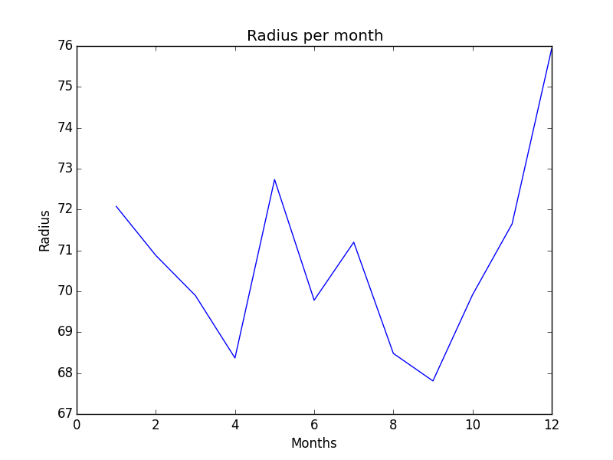
Size Variability in Kuroshio Eddies
Large variability-- trend is larger eddies in the spring, becoming smaller in the autumn.
Speculations: trend can be associated with seasonal variations in meandering.
Cyclonic Anticyclonic

Slide 34
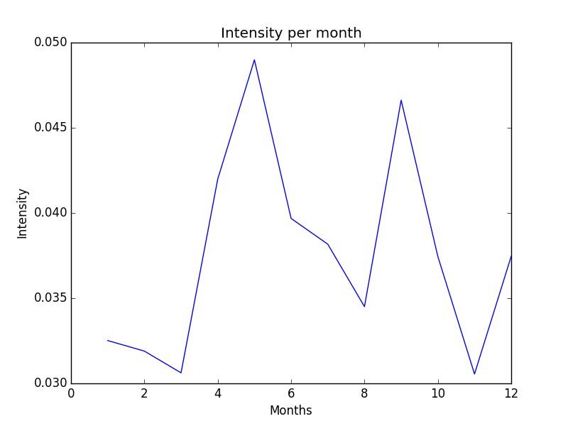
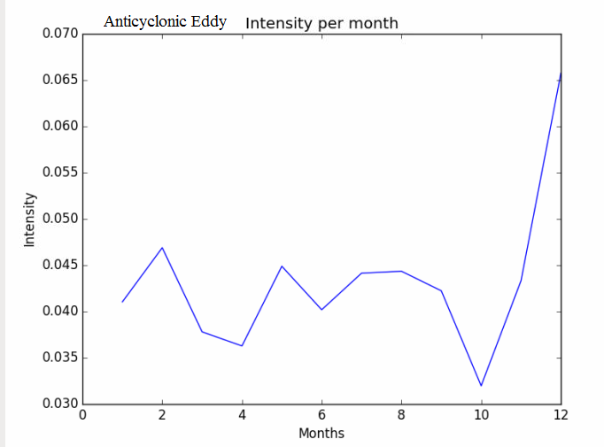
Intensity Variability in Kuroshio Eddies
Two distinct peaks for cyclonic eddies: May and September.
Anticyclonic eddies peak in late spring and remain relatively high through autumn. (while becoming more small and more numerous)
Cyclonic Anticyclonic

Slide 35
Interannual Variability of Kuroshio Eddies
Theory dictates that similar mechanisms would produce similar results in the Kuroshio region as were found in the Gulf Stream.
However, I was unable to find a robust link between eddy characteristics on an interannual scale and variabilities within the current itself.
Developing a climatology of variations in the average positioning of the Kuroshio Current would have most likely resolved these variations.
According to theory, the southern mode in the Kuroshio is even more correlated with meandering than in the Gulf Stream.

Slide 36
Conclusions
Gulf Stream
-60% of the variance in the annual positioning of the Gulf Stream is attributable to the NAO, some component to ENSO.
→ reflected in variations in annual cycle of anticyclonic eddy radii.
-Seasonal cycle is dominated by wind forcing.
Kuroshio Current
-Seasonal cycle of eddy characteristics comparable to Gulf Stream.
-More pronounced north/south pattern found here with more of a correlation between the southerly mode and meandering.

Slide 37
Questions?

